Slide 1
Implementing a risk-based and result-oriented approach in aviation training activities
to better address States’ needs
Nicolas Rallo
Regional Director
ICAO EUR/NAT Office
EATEO Conference
14 June 2022 - Cyprus

Slide 2
PREPARING FOR THE 41ST SESSION OF THE ICAO ASSEMBLY

Slide 3
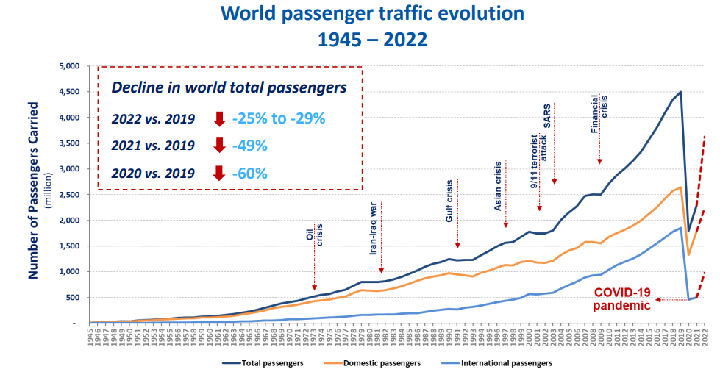
The aviation sector has been severely affected by the COVID-19 pandemic. Long lasting drop in traffic (more than 2/3 drop in 2020) is jeopardizing the economic viability of many operators
Recovery efforts will require us to work together to reconnect the world through a safe, secure, efficient, greener, more sustainable and resilient civil aviation system
Taking into account lessons learned from COVID-19 pandemic & building on HLCC 2021 outcomes

Slide 4
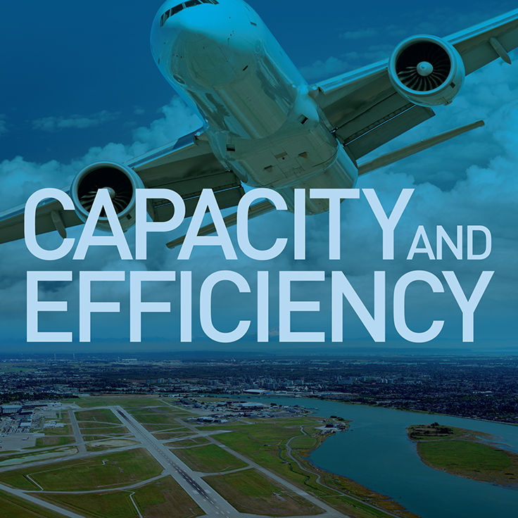
Assembly 41st Session – 27 Sep to 7 Oct 2022, hybrid event
INNOVATION
RESILIENCE
ICAO Strategic Objectives

Slide 5
GLOBAL AVIATION TRAINING (GAT)
ACTIONS AND WAY FORWARD

Slide 6
ICAO GAT KEY COMPETENCIES PROGRAMME
ICAO's Key Competencies Programme from GAT - ICAO on Vimeo

Slide 7
Mitigation actions taken during the COVID-19 Pandemic
ICAO Global Aviation Training (GAT) develod a plan,
Swift conversion of existing classroom courses into virtual classrooms
Development of short online courses on urgent topics to support the recovery of the sector
Targeted promotional strategies for online and virtual courses for Least Developing Countries and to support higher female participation in ICAO courses
Development of targeted partnerships on post-pandemic recovery topics
Contribution to iPacks with training components

Slide 8
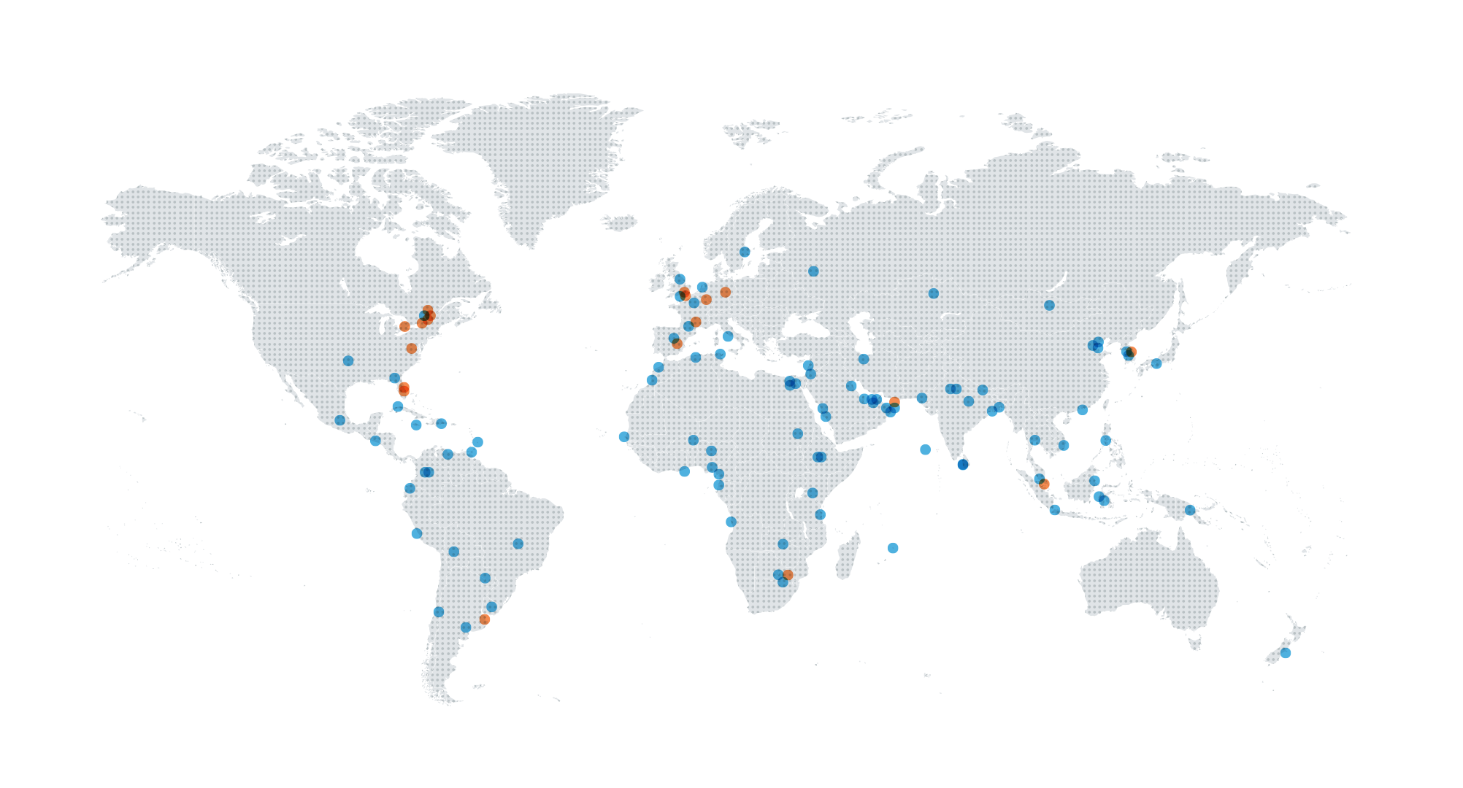
Enhancing collaboration with TRAINAIR PLUS™ Members
A network of over 100 training organizations, academic institutions, and other international organizations supporting the implementation of ICAO training activities
TRAINAIR PLUS Members
TRAINAIR PLUS Partners
13 Members
in EUR/NAT
113
93 Members 20 Partners
Activities Undertaken
Qualification
of virtual
instructors
Collaboration
and partnerships
Virtual library of 300+ courses
Training Sessions aligned with priority needs

Slide 9
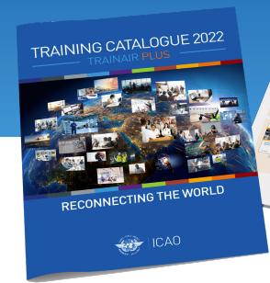
Increased Offering of Courses, in coordination with Regional Offices
Increased offering of training in Pandemic- recovery and resilience activities
Training Areas
Aerodromes | Air Navigation Services | Air Transport | Aviation Law
Aviation Management | Environment | Flight Safety and Safety Management | Facilitation
 | Security | Training Competency Development

Slide 10
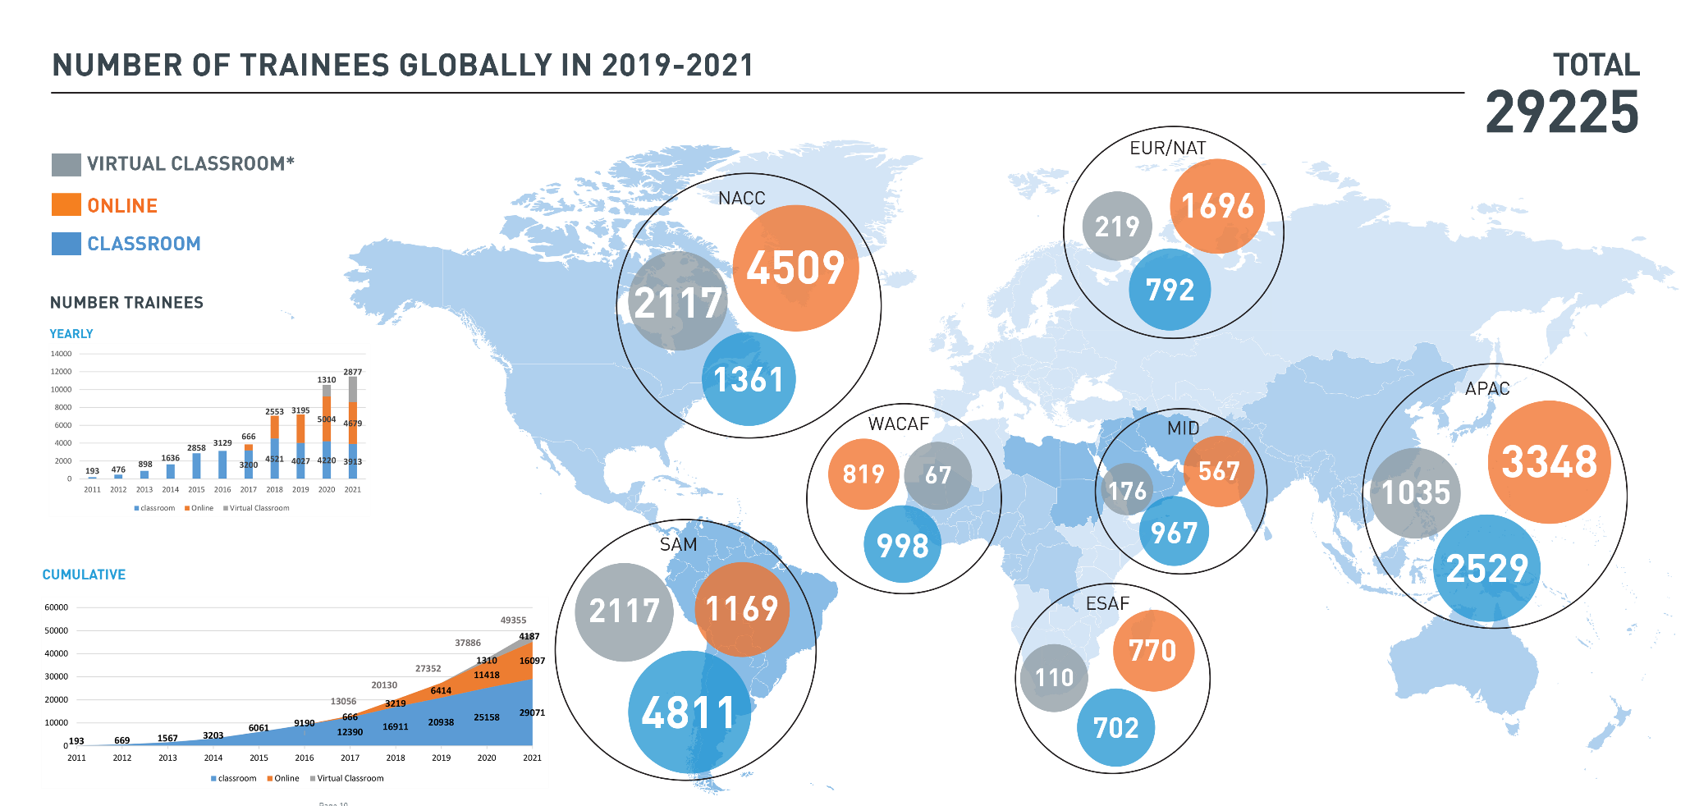
Number of Trainees

Slide 11
Way Forward
Enhancing Training Accessibility in a training hybrid model
Expanding and diversifying GAT portfolio of Training
Expanding Training Alliances

Slide 12
THE ICAO EUROPEAN AND NORTH ATLANTIC (EUR/NAT) REGIONAL OFFICE:
OUR APPROACH AND COMMITMENTS

Slide 13
Our Regions: a Variety of Situations, Needs and Priorities
ICAO EUR/NAT Regional Office
56 Contracting States
Supra National entities
RSOO/
RAIOs
ATM Coop
Regional Civil Aviation Conferences
ACAO, AFCAC, ECAC
EU, EAEU
Accredited to 56 Contracting States
Inter-regional interfaces with APAC, MID, AFI, NACC,SAT
A variety of situations, needs and priorities
Numerous coordination and cooperation channels
EUROCONTROL
EURASIA CC
EASA, IAC, ENCASIA

Slide 14
OUR STRATEGIC APPROACH
Collaborative – enhancing coordination, cooperation and promoting synergies with all stakeholders, especially regional organizations
State-centered
Risk based – progressing towards integrated risk management as appropriate
Result oriented – with a view to enhancing sustainability and resilience
Working as One ICAO, in close coordination with our ICAO HQ colleagues
Leaving no State behind in our accreditation area
Promoting intra- & inter-regional exchange of information and experience

Slide 15
OUR COMMITMENTS
To assist in understanding States’ challenges, key risks and priority needs through dialogue with our Member States and the analysis of available data and information, including from USOAP CMA and USAP CMA
To help explore, together with all stakeholders, possible innovative solutions to enhance training effectiveness and efficiency (scenario-based training, larger audience, availability in various ICAO working languages), especially when simulation is necessary (accident/ incident investigation; crisis management)
To help ensure Government support and management commitment (preparation, conduct, follow-up) to enhance sustainability and resilience of training activities’ outcomes

